Slide 1
COVID-19 and Pneumonia prediction from medical images
Vineeta Peddinti
Siva Yogitha Mokkapati
Data Mining(Spring II, 2020)
Dr. Partha Mukherjee

Slide 2
Context and Introduction
Chest X-rays gives images of our heart, lungs, etc. It’s common way to diagnose disease.
The most important thing is that it can also be used to tell whether a certain treatment is working.
So, in-order to solve the problem of manually classifying X-rays, we are building a model where the images are classified to Normal or Pneumonia, COVID or not.
Assuming that the class labels are not previously there, we are turning the classification problem to clustering problem.

Slide 3
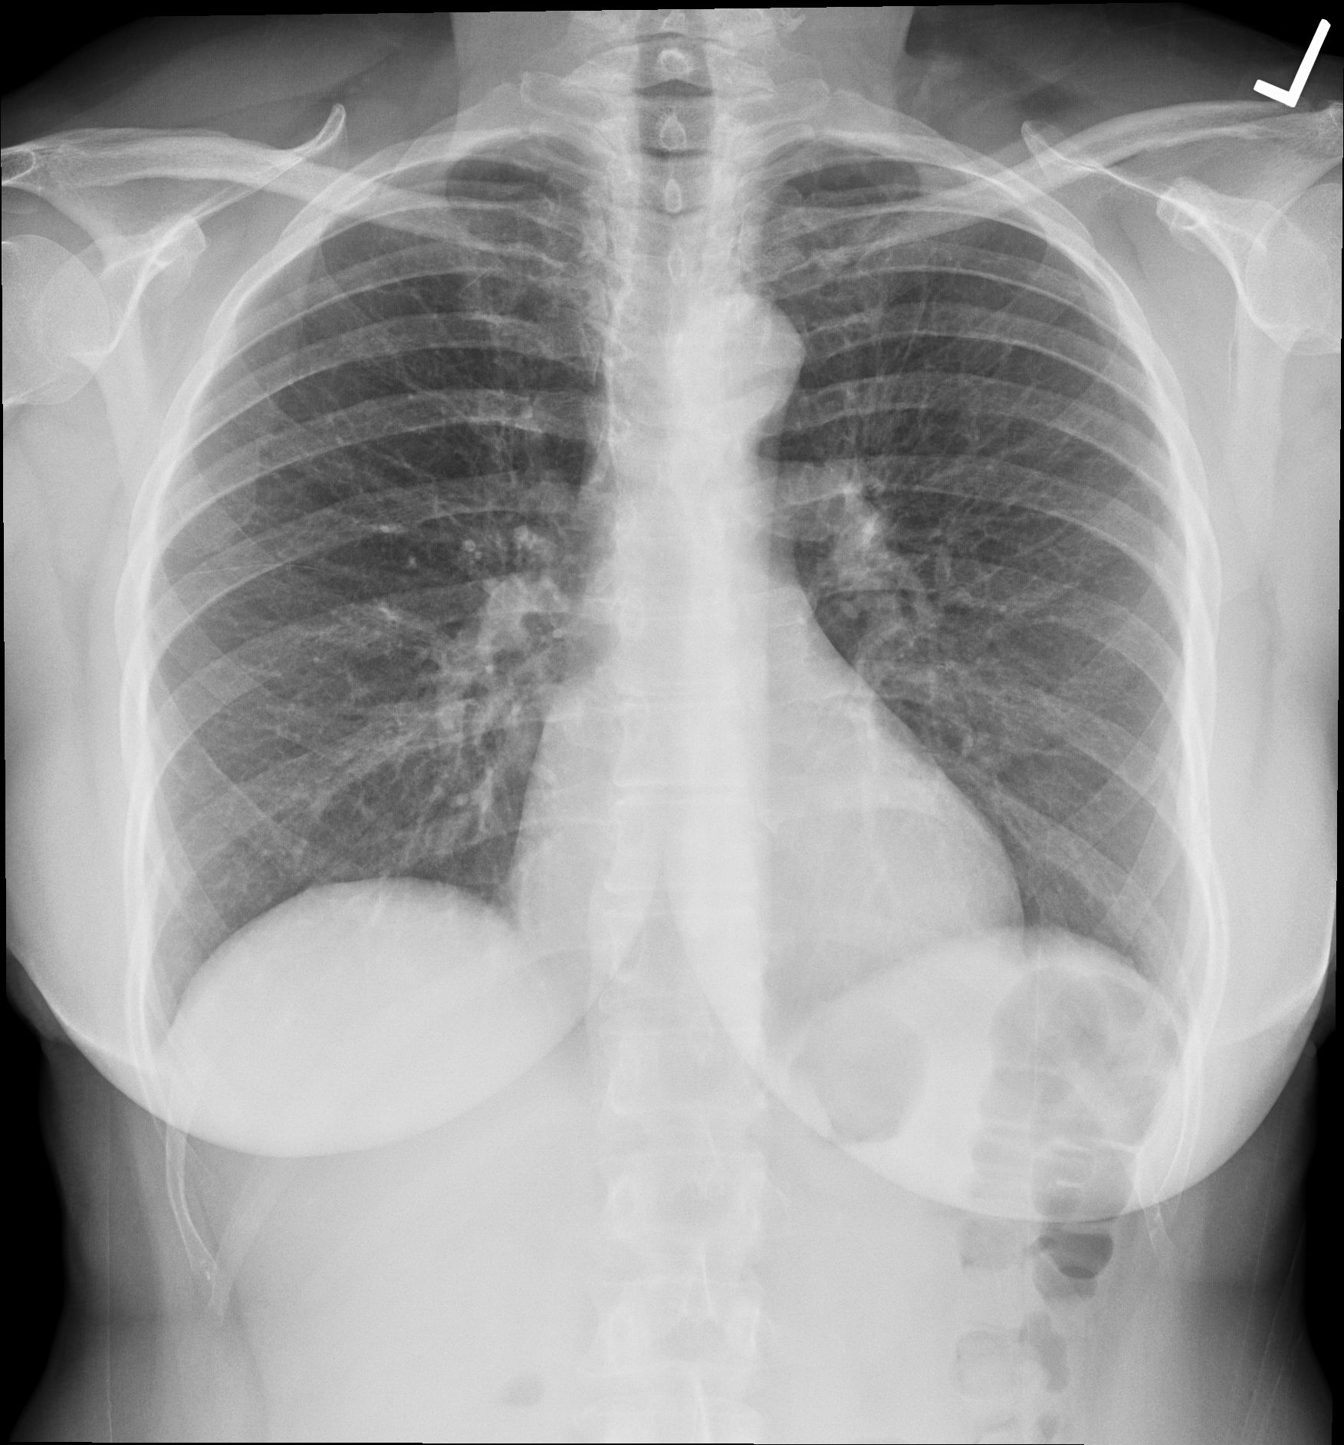

Problem Statement
Pneumonia ?
COVID ?
Normal ?

Slide 4
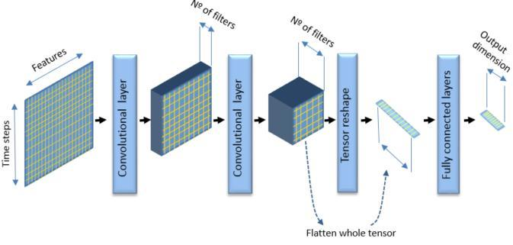

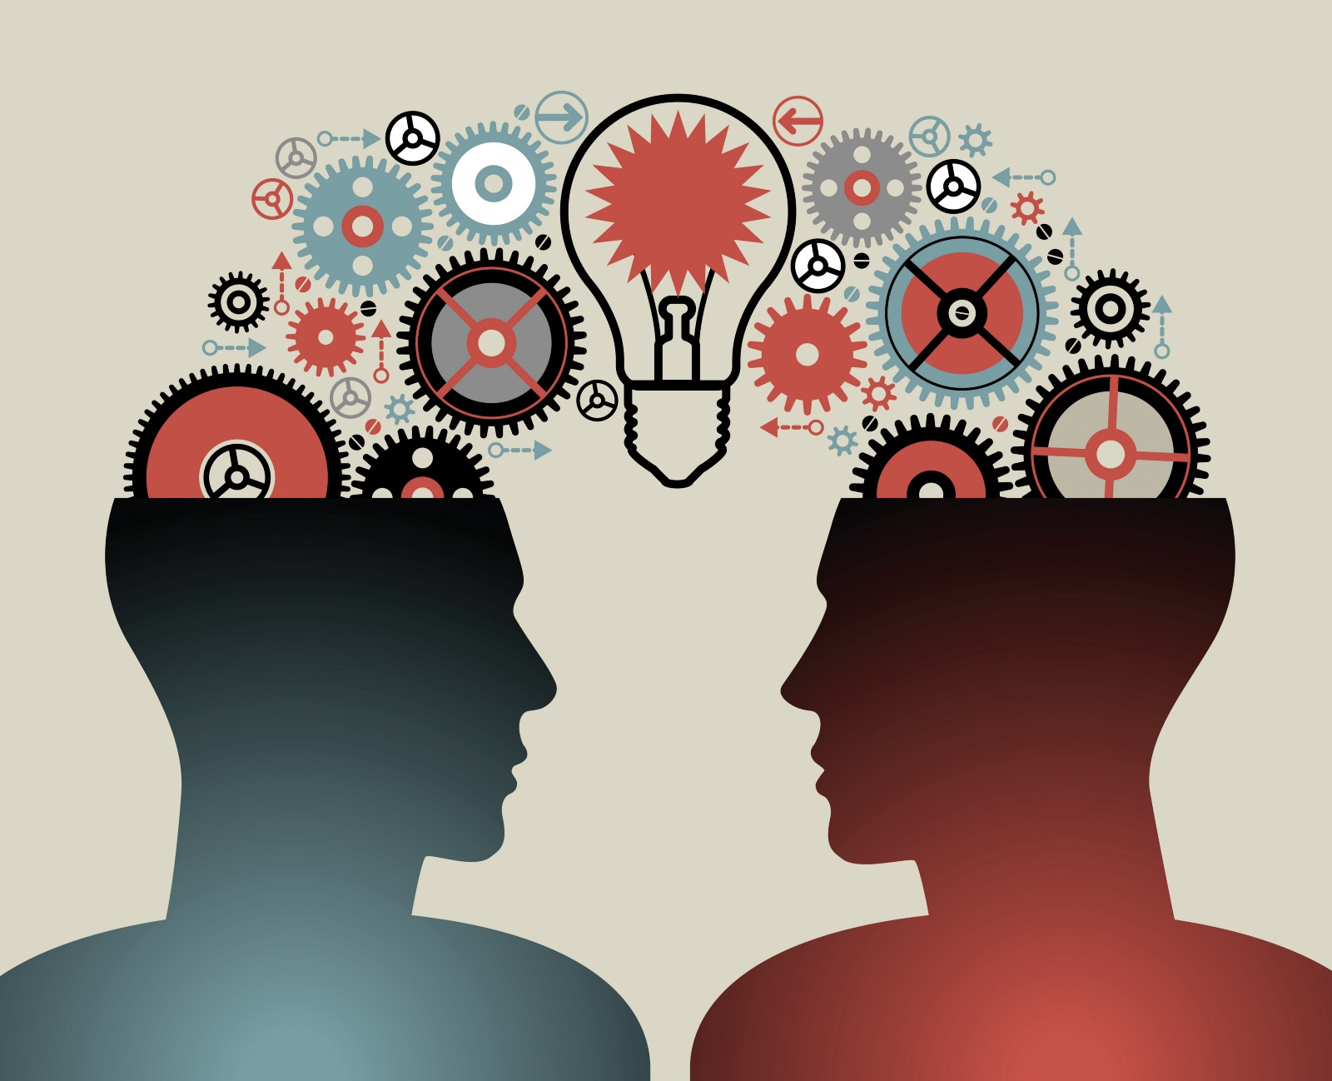
Related solutions / State of Art

Slide 5
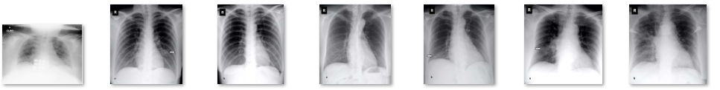
Data Collecting
The data source for Pneumonia CXRs is Kaggle.
https://www.kaggle.com/paultimothymooney/chest-xray-pneumonia
The dataset consists of 3875 of pneumonia and non-pneumonia CXR images.
The data source for COVID CXRs seeded from GitHub COVID-Chest X-ray-dataset. https://github.com/ieee8023/covid-chestxray-dataset
The dataset is still under development stage. We added some of the images from Pneumonia and Normal to this dataset in order to balance the classes.

Slide 6
Data Preprocessing
Traditional method SIFT method Transfer Learning
Image→ Array Image → SIFT Image →Inception
Noise removal SIFT → Array Inception →Array
Reshape
Normalization
Label Encoder

Slide 7
Methodology
For both the datasets:
STEP 1
SIFT image matching technique for image to array conversion.
Traditional image to array conversion technique.
Transfer learning Inception model technique for image to array conversion.
STEP 2
Reshape and normalize the arrays
STEP 3
Cluster them.
STEP 4
Evaluation
For Pneumonia: Find the PC components and repeat the above steps

Slide 8
Clustering Algorithms
K –means
BIRCH
Agglomerative – Single Linkage
Agglomerative – Complete Linkage
Agglomerative – Ward

Slide 9
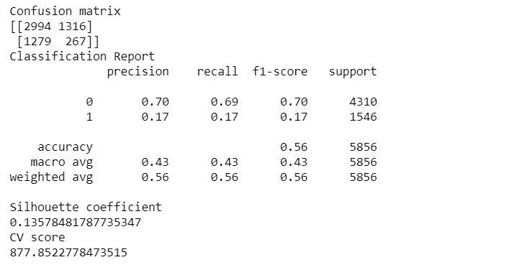
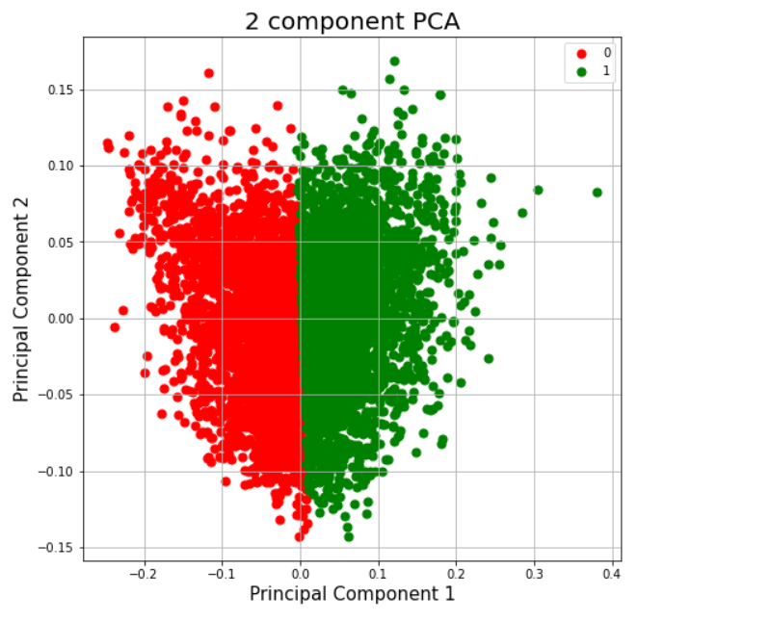
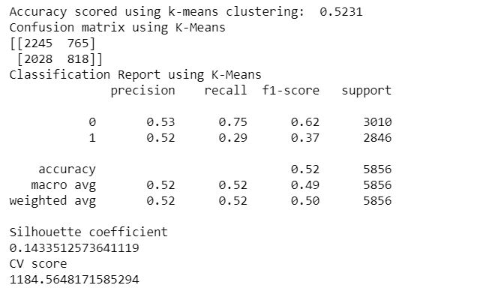
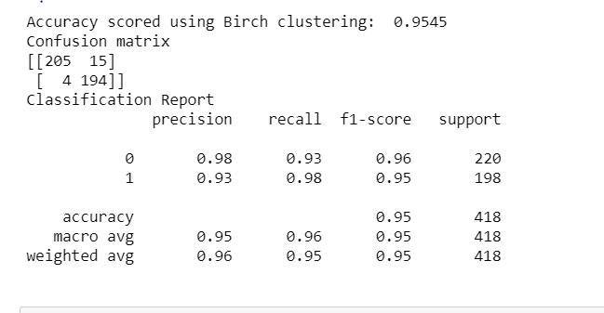
Evaluation - traditional method
For Pneumonia with traditional method almost all the clustering algorithms gave accuracy between 50-55. Among them the best result was given by ward. With PCA K-Means gave the best result. However, PC components explained only 37% of the variance.
For COVID analysis, even the tradition method gave a very good result with BIRCH which is:

Slide 10
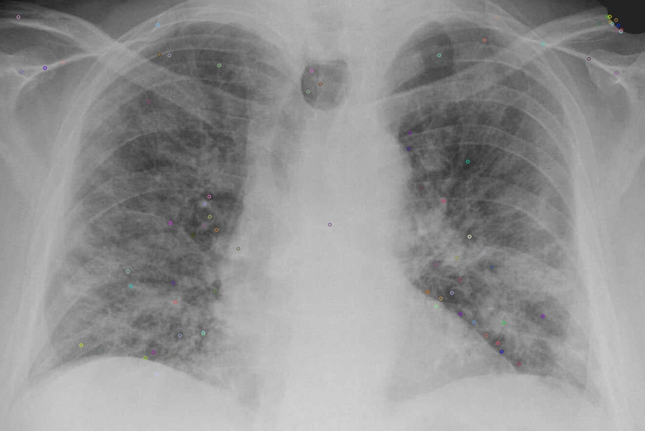
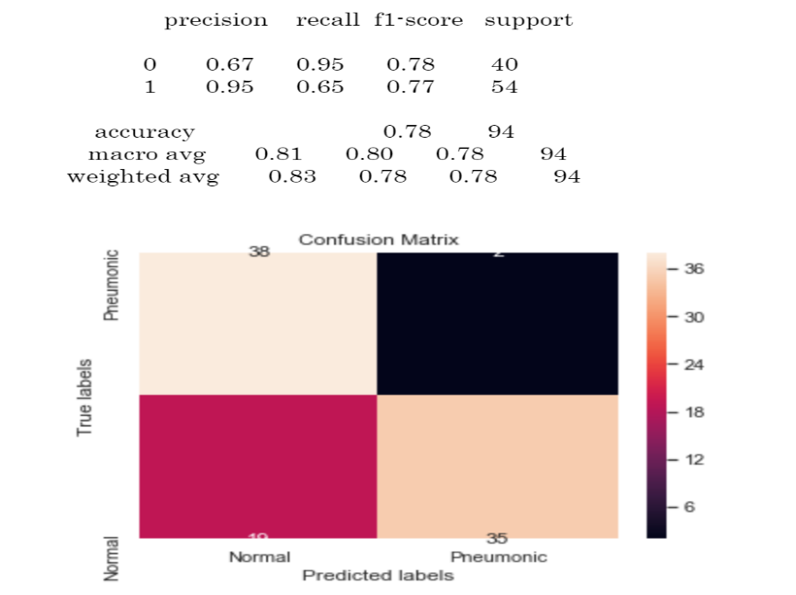
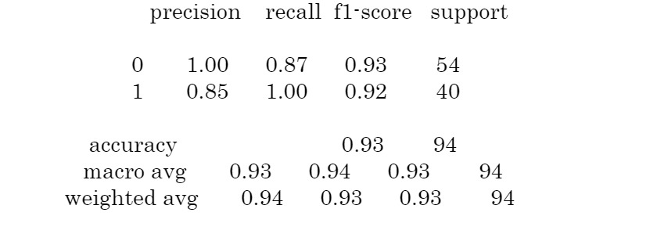
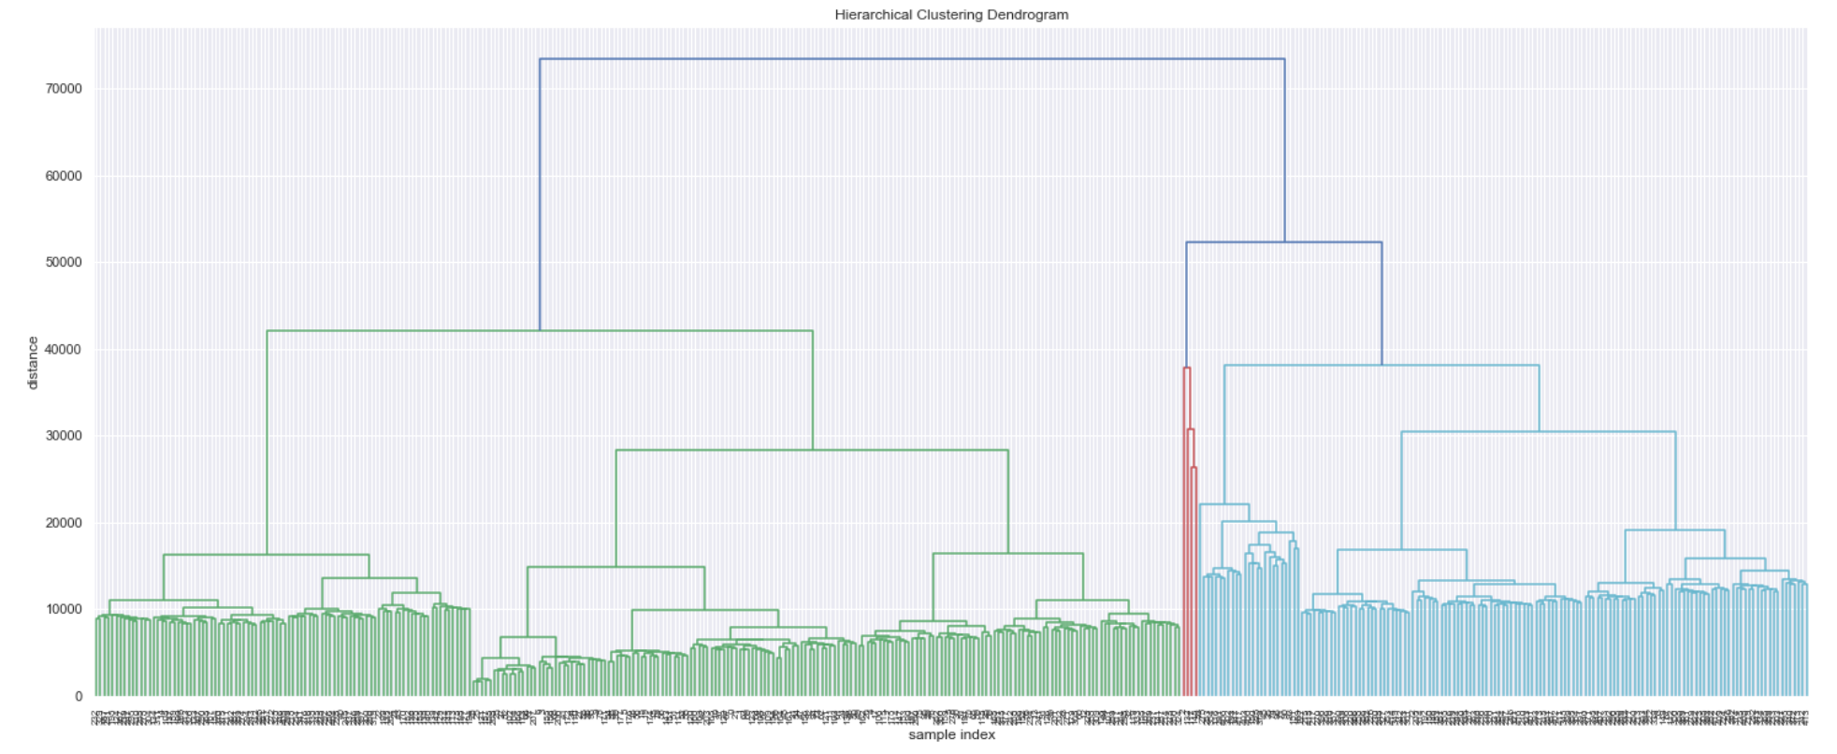
Evaluation- SIFT method
For Pneumonia considering all the features
(pixel array)K-means gave the best result of:
For COVID, BIRCH gave the best result among
the clustering algorithms for the SIFT technique. The performance metrics are:
Fig. WARD

Slide 11
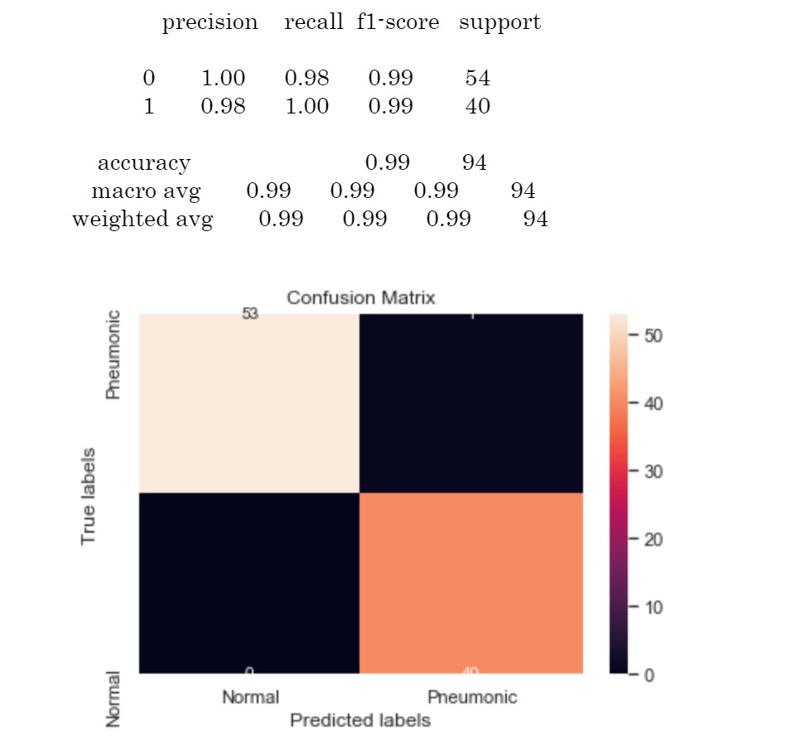
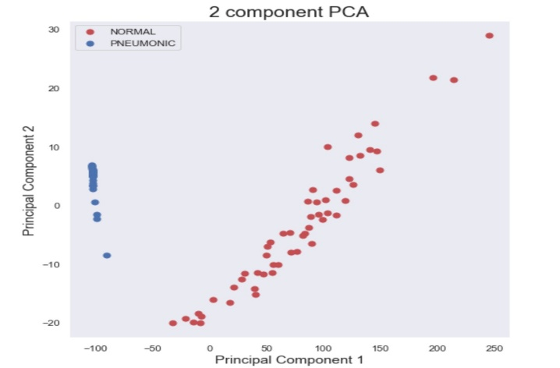
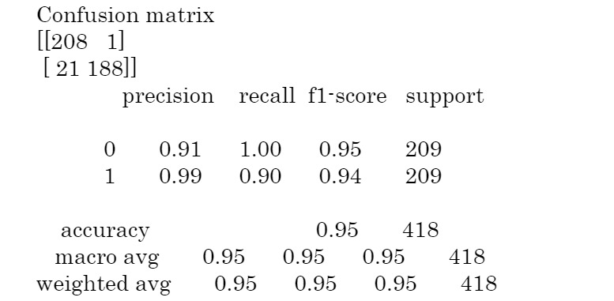
Evaluation - Inception method
Transfer learning gave the best results among all the 3 techniques and algorithms BIRCH, single linkage and ward gave the same result for all the performance metrics which are as shown below. Using PCA, the first 2 PC components were able to explain 98% of the variance. Clustering with these components gave the same result as with the original dataset for the clustering algorithms. The Distribution is as below:
On COVID the outstanding one was BIRCH:
Fig. Complete Linkage

Slide 12
Outcomes/Findings
Inception technique gave the best result for the Pneumonia dataset. However, all the techniques used were able to give good results.
For COVID dataset all the techniques gave good results (all the performance measures were >90%) using BIRCH algorithm. May be because the dataset is small even the traditional method gave the same result as a neural network method.
One limitation is that for COVID identification the dataset is very small (<300). Had there been a larger dataset, we would have known the reliability of the results.
Also, other image matching techniques could be used. With respect to deep learning other transfer learning models or own models can be built.

Slide 13
Bibliographical References
https://towardsdatascience.com/prototyping-a-cnn-to-diagnose-covid-19-from-chest-x-ray-e1224a8e7795
https://www.kaggle.com/therealcyberlord/pneumonia-detection-using-cnn
https://www.researchgate.net/publication/228943913_Clustering_visually_similar_images_to_improve_image_search_engines#pf4
https://opencv-python-tutroals.readthedocs.io/en/latest/py_tutorials/py_feature2d/py_sift_intro/py_sift_intro.html
https://arxiv.org/ftp/arxiv/papers/1710/1710.02726.pdf
https://www.freecodecamp.org/news/getting-started-with-tesseract-part-ii-f7f9a0899b3f/
https://towardsdatascience.com/the-5-clustering-algorithms-data-scientists-need-to-know-a36d136ef68
https://towardsdatascience.com/detecting-covid-19-induced-pneumonia-from-chest-x-rays-with-transfer-learning-an-implementation-311484e6afc1
https://medium.com/@franky07724_57962/using-keras-pre-trained-models-for-feature-extraction-in-image-clustering-a142c6cdf5b1
https://towardsdatascience.com/image-clustering-using-transfer-learning-df5862779571
https://medium.com/@ksusorokina/image-classification-with-convolutional-neural-networks-496815db12a8

Slide 14


TIME FOR DEMO

